Slide 1

Operating systems: The Dining Philosophers Problem
Dahir Mussa B00107811
Patricia Mc Keon B00123338
Brian Maher B00123312
Robert Preston B00128295

Slide 2
Overview
Introduction
Background
Types of Solutions
Semaphore FourChairs Solution
Program codes
Philosopher-4chairs-main.cpp
Philosopher-4chairs.cpp
Philosopher-4chairs.h
Results of the running program
How to run the program
Running program
Thread interface

Slide 3
Overview Continued
Visualizing
Thread Interface
Thread status
History Graph
Thread Hierarchy
Conclusion
Future Work
References

Slide 4
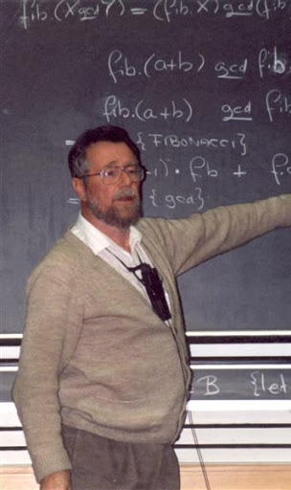
Background
Edsger Wybe Dijkstra invented the dining philosopher’s problem in 1965
There are three solutions to this problem:
Mutual Exclusion Lock
Semaphore
Monitor

Slide 5
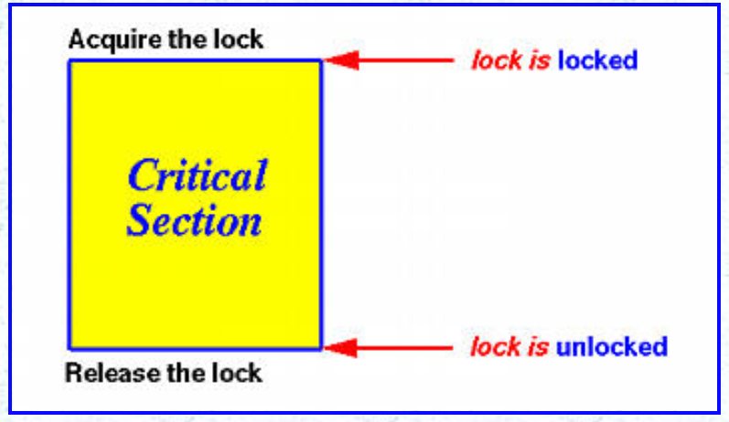
Mutual Exclusion Locks

Slide 6
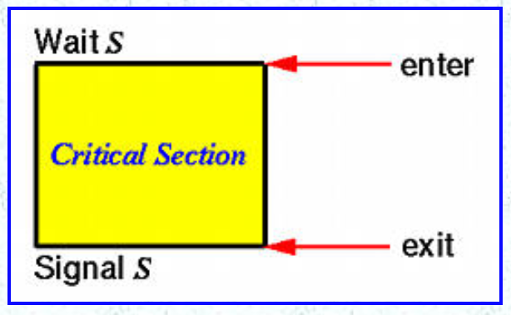
Semaphore

Slide 7
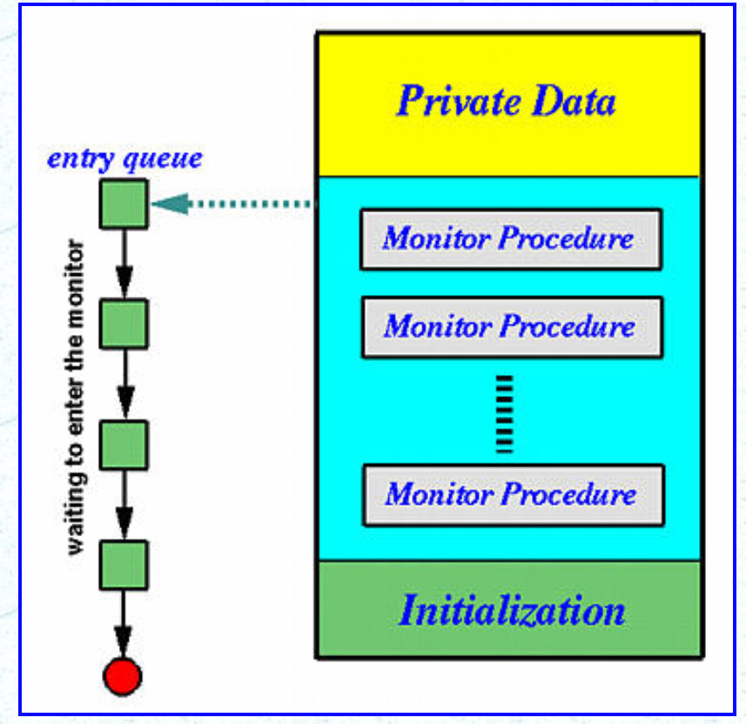
Monitor

Slide 8
Semaphores - Four Chair Solution
The Four chairs solution which is one of the dining philosophers problems, when four philosophers have already sat down, the fifth philosopher is blocked.
Allowing four philosopher to sit down at the table at the same time, those four philosophers will pick up four chopsticks that is near to them.

Slide 9
Philosopher-4chairs-main.cpp
#include <iostream>
#include <stdlib.h>
#include "philosopher-4chairs.h“
int main(int argc, char *argv[]) {
Philosopher *Philosophers[NUM_OF_PHILOSOPHERS];
int i, Iteration;
if (argc != 2) {
cout << "use " << argv[0] << " #-of-iterations." << endl;
exit(0);
} else
Iteration = abs(atoi(argv[1]));

Slide 10
Philosopher-4chairs-main.cpp (cont.)
// create all the philosopher threads and fire them up
for (i = 0; i < NUM_OF_PHILOSOPHERS; i++) {
Philosophers[i]= new Philosopher(i, Iteration);
Philosophers[i]->Begin();
}
// wait for philosopher thread
for (i = 0; i < NUM_OF_PHILOSOPHERS; i++)
Philosophers[i]->Join();
Exit(); // main thread exits
return 0;
}

Slide 11
Philosopher-4chairs.cpp
#include <iostream>
#include "philosopher-4chairs.h”
static Semaphore Fourchairs("FOURCHAIRS", NUM_OF_PHILOSOPHERS - 1);
static Mutex Chopstick1("Chopstick1");
static Mutex Chopstick2("Chopstick2");
static Mutex Chopstick3("Chopstick3");
static Mutex Chopstick4("Chopstick4");
static Mutex Chopstick5("Chopstick5");
static Mutex *Chopstick[NUM_OF_PHILOSOPHERS] =
{ &Chopstick1, &Chopstick2, &Chopstick3, &Chopstick4, &Chopstick5 };

Slide 12
Philosopher-4chairs.cpp (Cont.)
strstream *Filler(int n)
{
int i; strstream *Space;
Space = new strstream;
for (i = 0; i < n; i++)
(*Space) << ' '; (*Space) << '\0';
return Space;
}
Philosopher::Philosopher(int number, int iter)
:No(Number), Iteration(iter){
ThreadName.seekp(0, ios::beg);
ThreadName << "Philosopher" << Number << '\0’;
};

Slide 13
Philosopher-4chairs.cpp (Cont.)
void Philosopher::ThreadFunc() {
Thread::ThreadFunc();
strstream *Space;
int i;
Space = Filler(no*2);
for (i=0; i < Iteration; i++) {
Delay();
FourChairs.Wait(); // allows 4 to sit down
Chopstick[No]->Lock();
Chopstick[(No + 1) % NUM_OF_PHILOSOPHERS]->Lock();

Slide 14
Philosopher-4chairs.cpp (Cont.)
cout << Space->str() << ThreadName.str()
<< " begin eating." << endl;
Delay();
cout << Space->str() << Threadname.str()
<< " finish eating." << endl;
Chopstick[No]->Unlock();
Chopstick[(No+1)%NUM_OF_PHILOSOPHERS]->Unlock();
FourChairs.Signal(); // release the chair
}
Exit();
}
// end of Philosopher.cpp file

Slide 15
Philosopher-4chairs.h
#ifndef _PHILOSOPHER_H
#define _PHILOSOPHER_H
#include "ThreadClass.h“
#define NUM_OF_PHILOSOPHERS 5
class Philosopher: public Thread
{
public:
Philosopher(int Number, int iter); // constructor
private:
int No; // position of the philosopher
int Iteration;
void ThreadFunc();
};
#endif

Slide 16
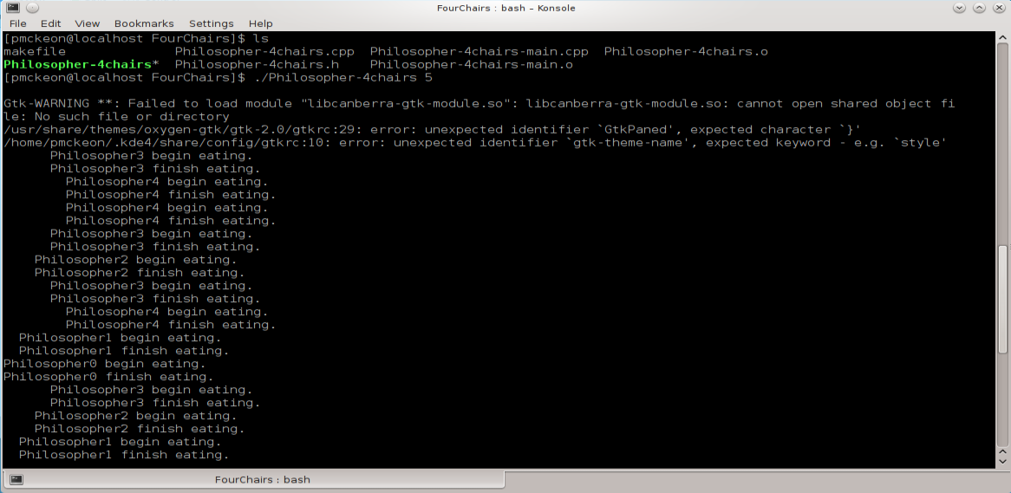
Running program

Slide 17
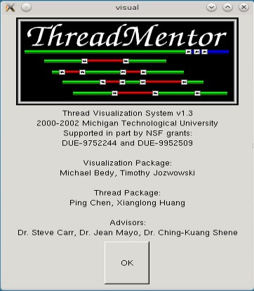
Thread interface
When a program that is compiled with ThreadMentor starts, it automatically brings up ThreadMentor’s visualization subsystem.

Slide 18
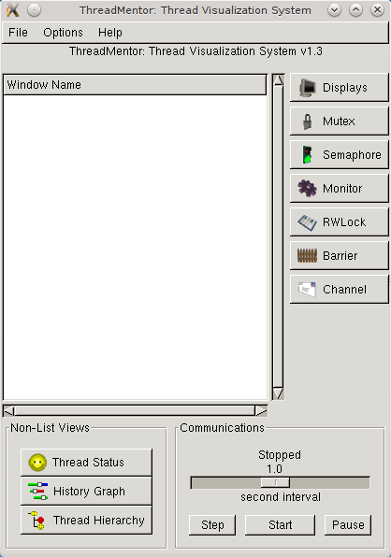
Thread interface
Once OK is clicked the program will display the main window. The main elements of this main windows are:
Display Area
Control of the execution of the threaded program

Slide 19
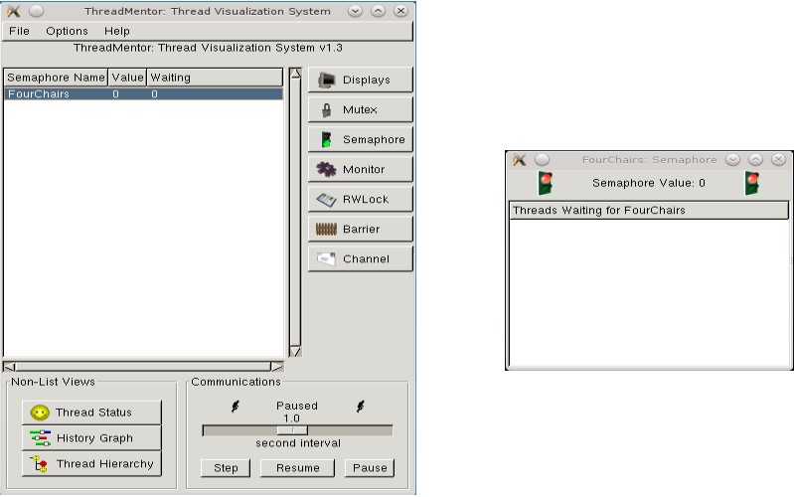
Thread Visualization System

Slide 20
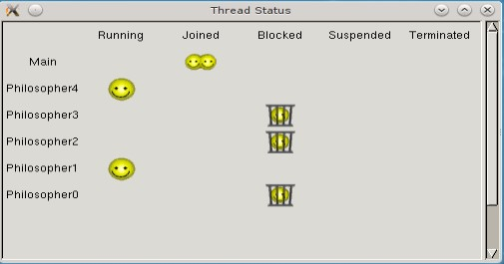
Thread Status

Slide 21
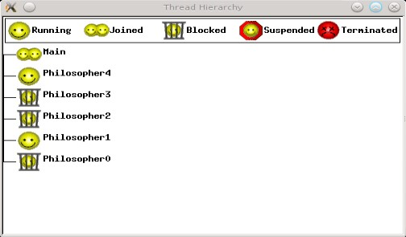
Thread Hierarchy

Slide 22
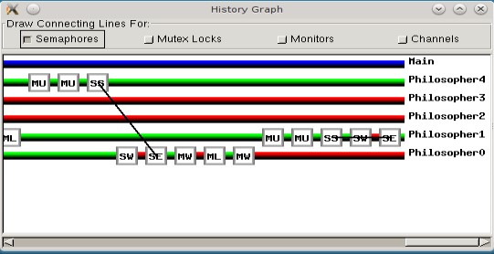
History Graph

Slide 23
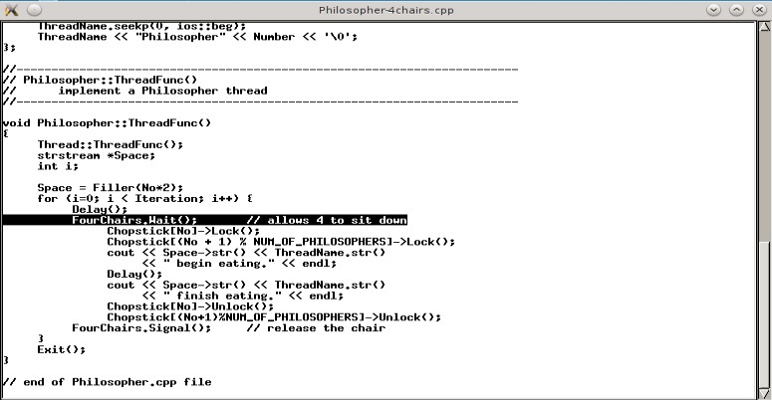
SW-Tag

Slide 24
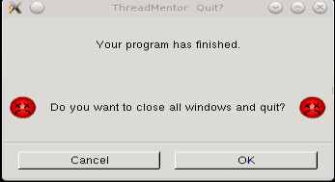
Finished Program

Slide 25
Future Work
Download
Download the other code solutions
Run
Run the code and see the difference between each solution
Check
Check other problems and their solutions e.g. The Smokers Problem, ProducerConsumer, and The Roller Coaster Problem

Slide 26
Conclusion
Advantages
Only allow one process into the critical section
There is no resource wastage because of busy waiting in semaphores
Disadvantages
Wait & signal must be implemented in the correct order to prevent deadlock
Large scale use can lead to loss of modularity
More prone to programmer error

Slide 27
References
[1]. Pages.mtu.edu. 2021. ThreadMentor: The Dining Philosophers Problem with Four Chairs. [online] Available at: <https://pages.mtu.edu/~shene/NSF-3/e-Book/SEMA/TM-example-philos-4chairs.html> [Accessed 17 April 2021].
[2]. Medium. 2021. The Dining Philosopher’s Problem. [online] Available at: <https://medium.com/swlh/the-dining-philosophers-problem-bbdb92e6b788> [Accessed 17 April 2021].
[3]. Pages.mtu.edu. 2021. ThreadMentor: Visualizing Thread Execution. [online] Available at: <https://pages.mtu.edu/~shene/NSF-3/e-Book/FUNDAMENTALS/VISUAL/basic.html> [Accessed 17 April 2021].
[4]. Pages.mtu.edu. 2021. ThreadMentor: Visualizing Semaphores. [online] Available at: <https://pages.mtu.edu/~shene/NSF-3/e-Book/SEMA/VISUAL/VISUAL-sema.html> [Accessed 17 April 2021].
[5]. Pages.mtu.edu. 2021. ThreadMentor: Visualizing Thread Execution. [online] Available at: <https://pages.mtu.edu/~shene/NSF-3/e-Book/FUNDAMENTALS/VISUAL/basic.html> [Accessed 17 April 2021].

